Slide 1
Special Topic: Light Sources
Eric Prebys

Slide 2
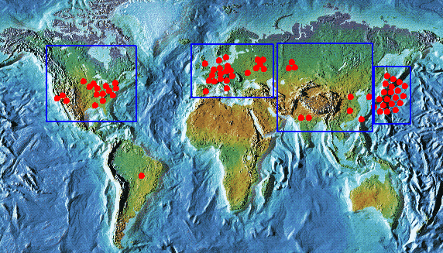
There are a lot more light sources than frontier research machines
Wikipedia lists about 60 light sources worldwide

Slide 3
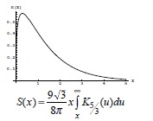
Fundamental Principle
Bending electrons emit radiation along their path

Slide 4
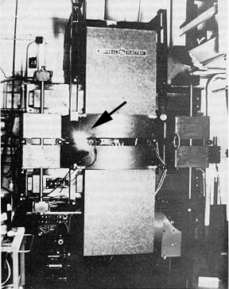
First Observation of Synchrotron Radiation
Synchrotron Radiation was first searched for in 1944 at GE’s 100 MeV electron
Energy loss was seen, but because of a calculational error, they searched in the microwave region and missed the visible light, because the acceleration chamber was opaque
In 1947, John Paul Blewett got permission to build a 70 MeV synchrotron at GE with transparent windows, and observed synchrotron radiation for the first time.

Slide 5
First Generation: Parasitic Operations
Examples
SURF (1961): 180 MeV UV synchrotron at NBS
CESR (CHESS, 70’s): 6 GeV synchrotron at Cornell
Numerous others
Typically large emittances, which limited brightness of the beam

Slide 6
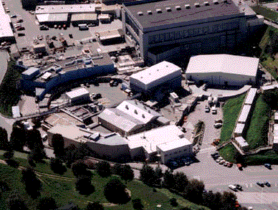
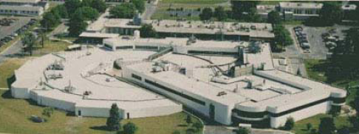
Second Generation: Dedicated
Examples:
1981: 2 GeV SRS at Daresbury (ε=106 nm-rad)
1982: 800 MeV BESSY in Berlin (ε=38 nm-rad)
1990: SPEAR II becomes dedicated light source (ε=160 nm-rad)
Often include “wigglers” to enhance SR

Slide 7

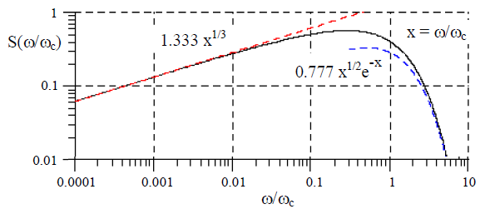
Typical 2nd Generation Parameters
Beam sizes
σ_{y}~1 mm
σ_{y’}~.1 mrad
σ_{x}~.1 mm
σ_{x‘}~.03 mrad
Broad spectrum
High flux
Typicall 10¹³ photons/second/mradian for 3 GeV, 100 mA dipole source at E_{crit}

Slide 8
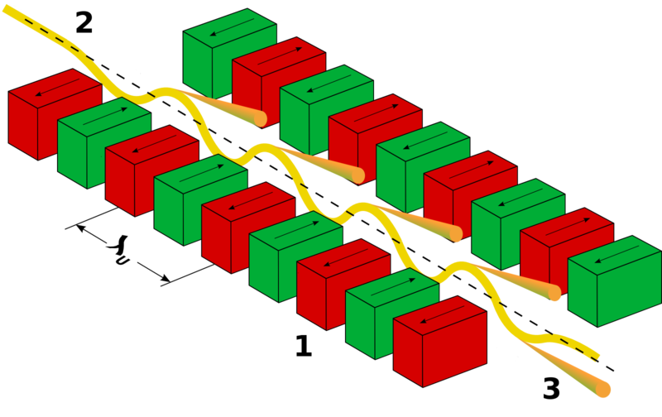
Undulators
Periodic Magnets
In rest frame of electron
Electron oscillates coherently with (contracted) structure, and releases photons with the same wavelength.
In the lab frame, this is Doppler shifted, so
So, λ on the order of 1cm ➔X-rays.

Slide 9
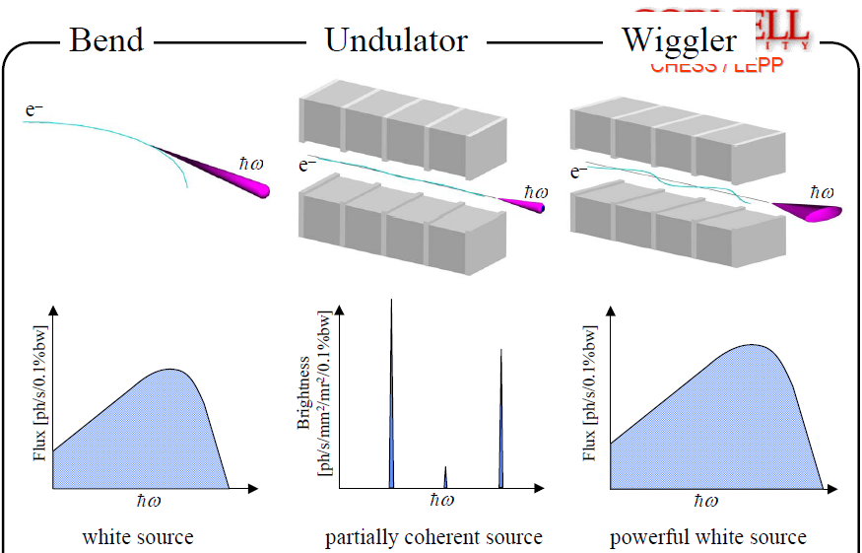
Bends, Undulators, and Wigglers*
*G. Krafft

Slide 10
3rd Generation (Undulator) Sources
High Brightness
10¹⁹ compared to 10¹⁶ for 2nd generation sources
Emittance ~1-20 nm-rad

Slide 11
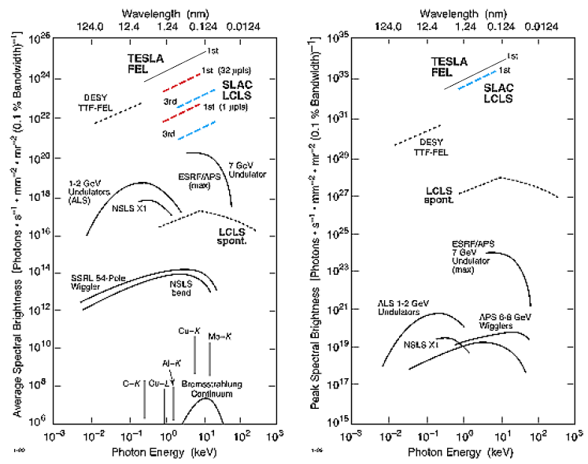
Summary of Parameters

